Slide 1
Corporate Finance

Slide 2
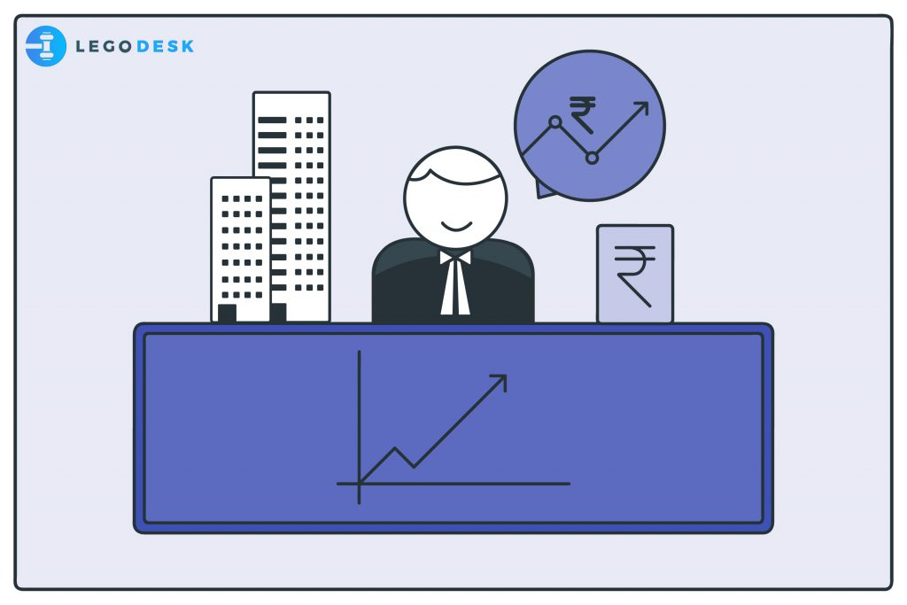
What are the goals of successful companies ?
What are the key attributes of successful companies ?
How does a expertise in Finance help a Company to become successful?

Slide 3
Goals of successful companies
First goal is to deliver products / services that are highly valued by customers
Sell their products / services at prices that are high enough to cover cost and to compensate owners and credits for use of their money.

Slide 4
Florence Ice cream Joint Milk ,Sugar, Gelatin, some other ingredients investment of 4000 Ringitts 5 litres of Ice Cream

Slide 5
Key attributes of successful companies
Successful companies has skills people’s at all levels inside the company- APPLE, GOOGLE,
Successful have strong relationships with groups outside the company such as CRM
Successful companies has enough funding to execute their plans and support their operations . Example: Infosys

Slide 6
Does a expertise in Finance help a Company to become successful?
MBA course will give you the skills you need to help a company achieve with first goal i.e. producing goods and services that customers wants
To help the company to accomplish second goal , you must be able to evaluate any proposal whether it relates to Marketing, Production, Strategy or any other area and let only the projects that add value for your investors.
For this you just have expertise in Finance. Thus Finance is critical part of an MBA education.

Slide 7
Corporate Lifecyle
What are the key difference between Sole Trading, Partnership & Corporation.

Slide 8
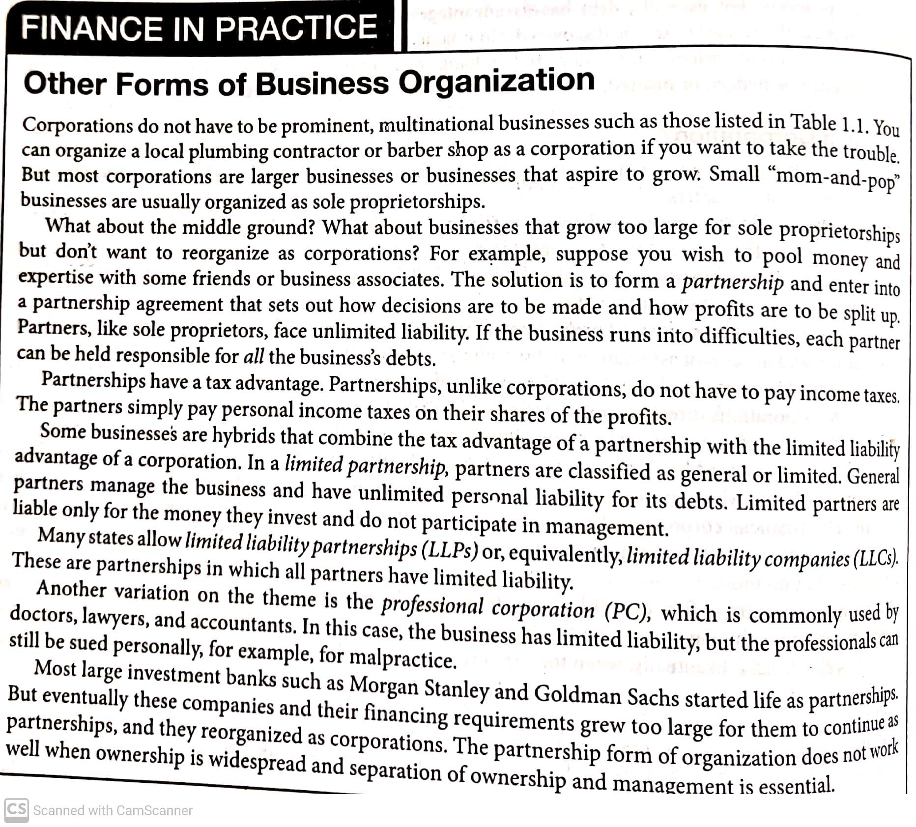

Slide 9
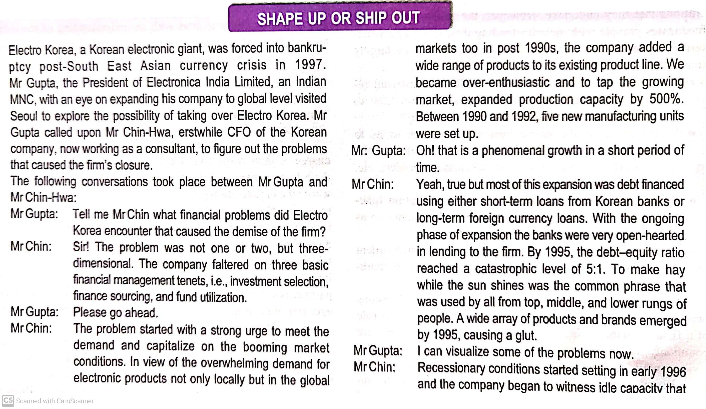
-

Slide 10
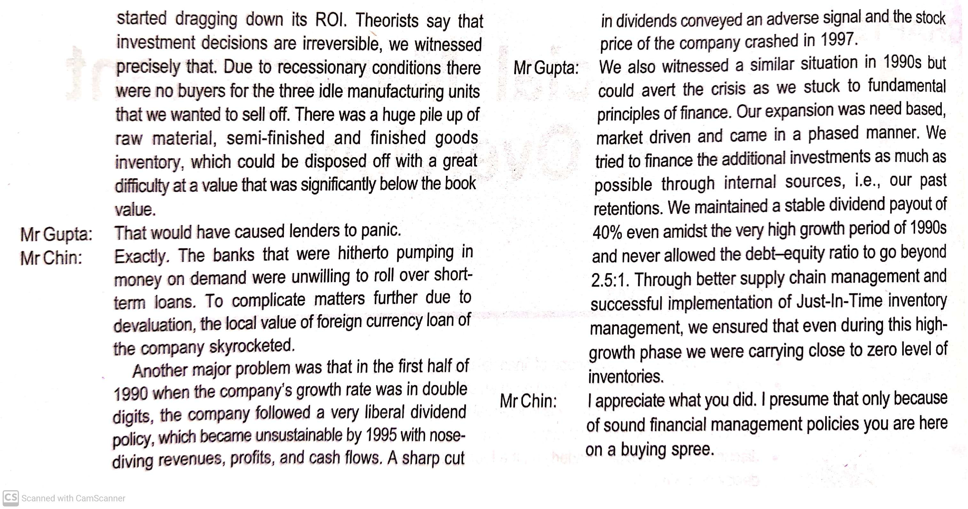

Slide 11
Three Important Decisions in Financial Management
Investment Decision
Financing Decision
Working Capital Decision/Short Term Capital Adequacy decision
Dividend Decisions

Slide 12
I am starting a business , it is health drink business-Financing Decision
Capital
Planning the financial
10000 Ringitts as capital
Actual requirement is 15000Ringitts
Borrow from a bank or find a friend who will invest

Slide 13
What will I do with the Capital that I have got Investment decision is for long term
Premises Land and Building
Employee
Assets –Machinery, furniture, computer

Slide 14
To Make Health Drink
Water,sugar ,raw materials ,milk , electric bill ,
Incurring expenses to run the business on day to day basis is known as working Capital is short term in nature
What is the period for Short term ?
One year or upto one year = 365 days

Slide 15
Dividend Decision Profits high-5000Ringitts
Pay for the liability -1000
500 ringitts as returns to me or it is called as dividends to me 4000

Slide 16
Major Objectives of Financial Management
Profit Maximisation
Shareholders wealth Maximisation is important

Slide 17
What are the major finance Functions/ management in an organisation ?
Financial planning,
Procurement
Utilisation
Controlling
Share the returns /profits

Slide 18
INVESTMENT DECISIONS: PURCHASE OF REAL ASSETS
FINANCING DECISIONS: SALE OF FINANCIAL ASSETS.

Slide 19
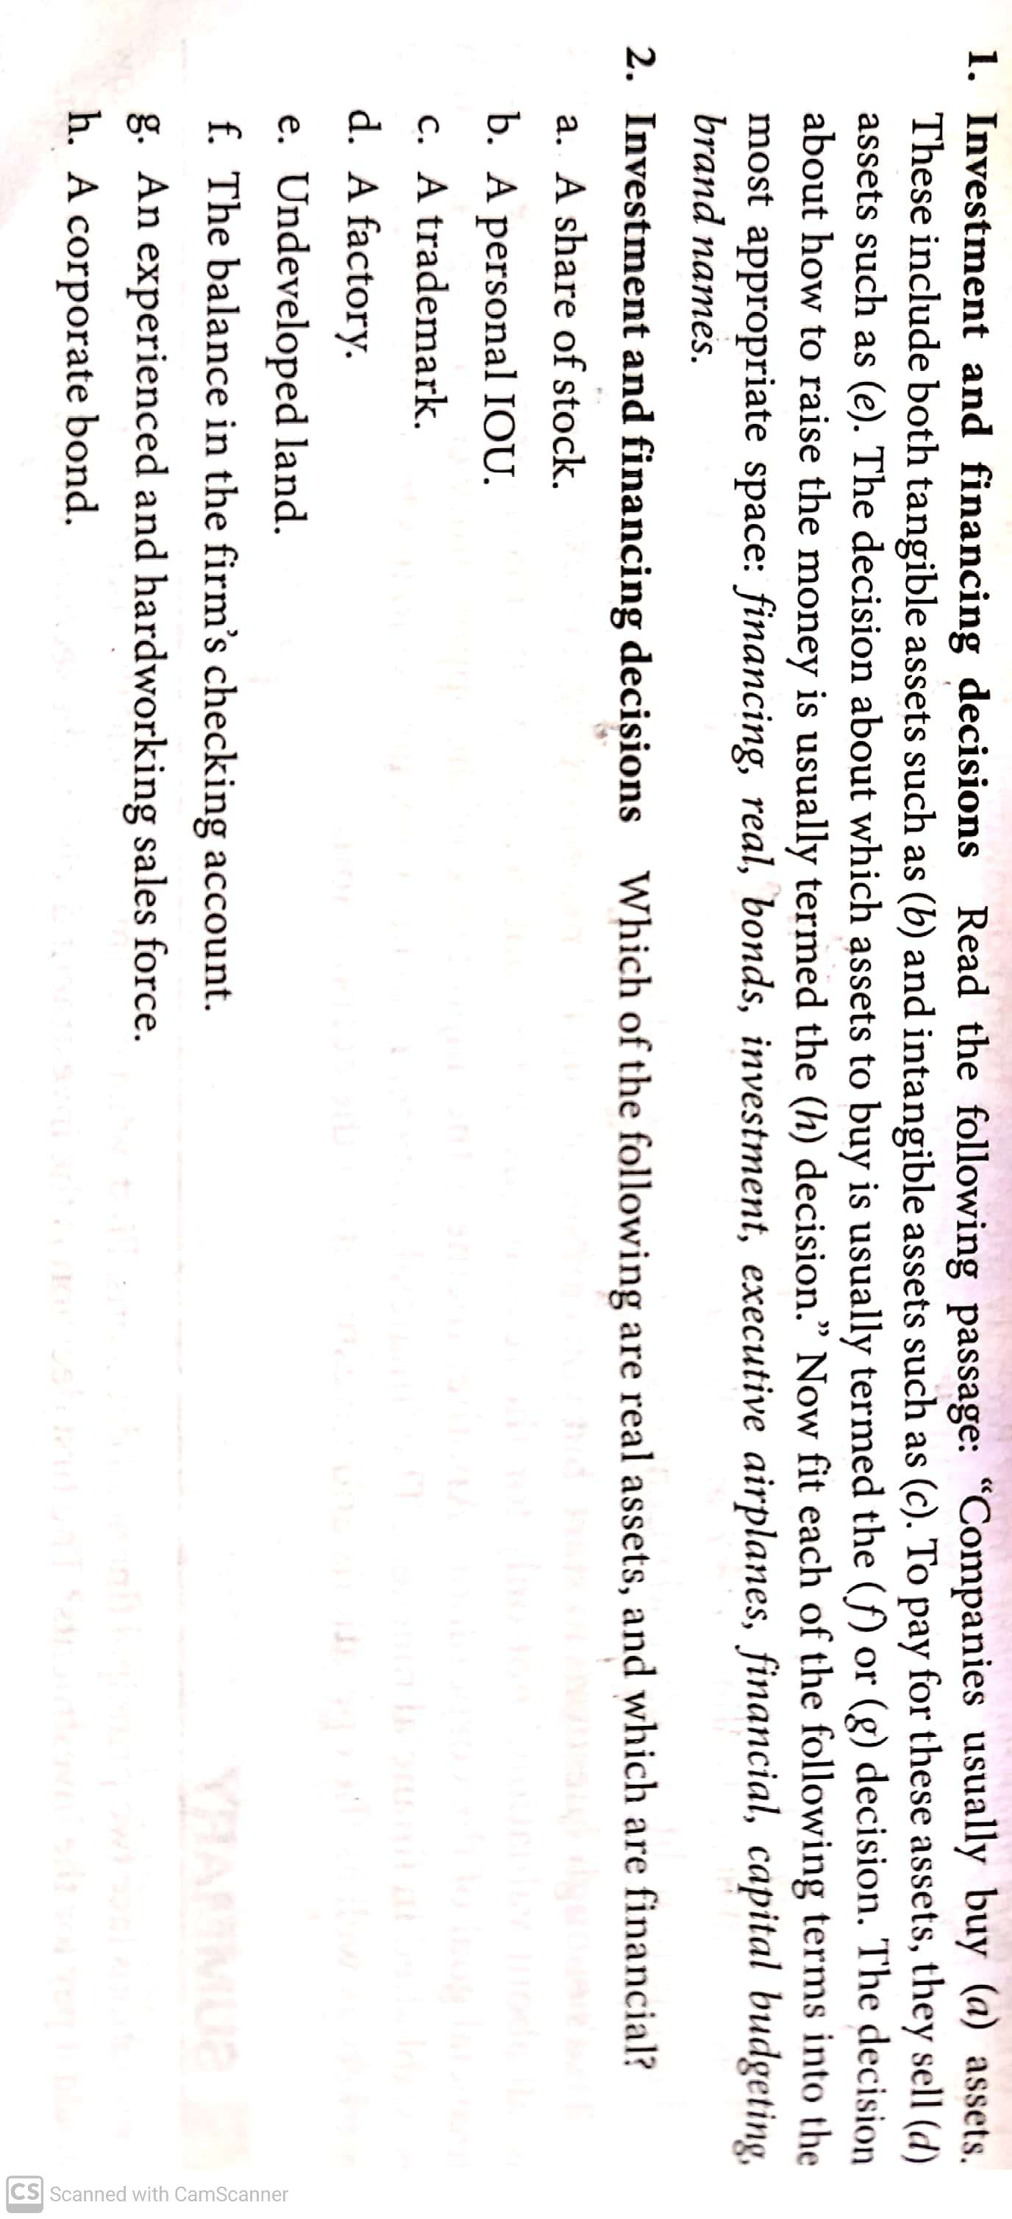
Areas of Decision Making in Financial Management

Slide 20
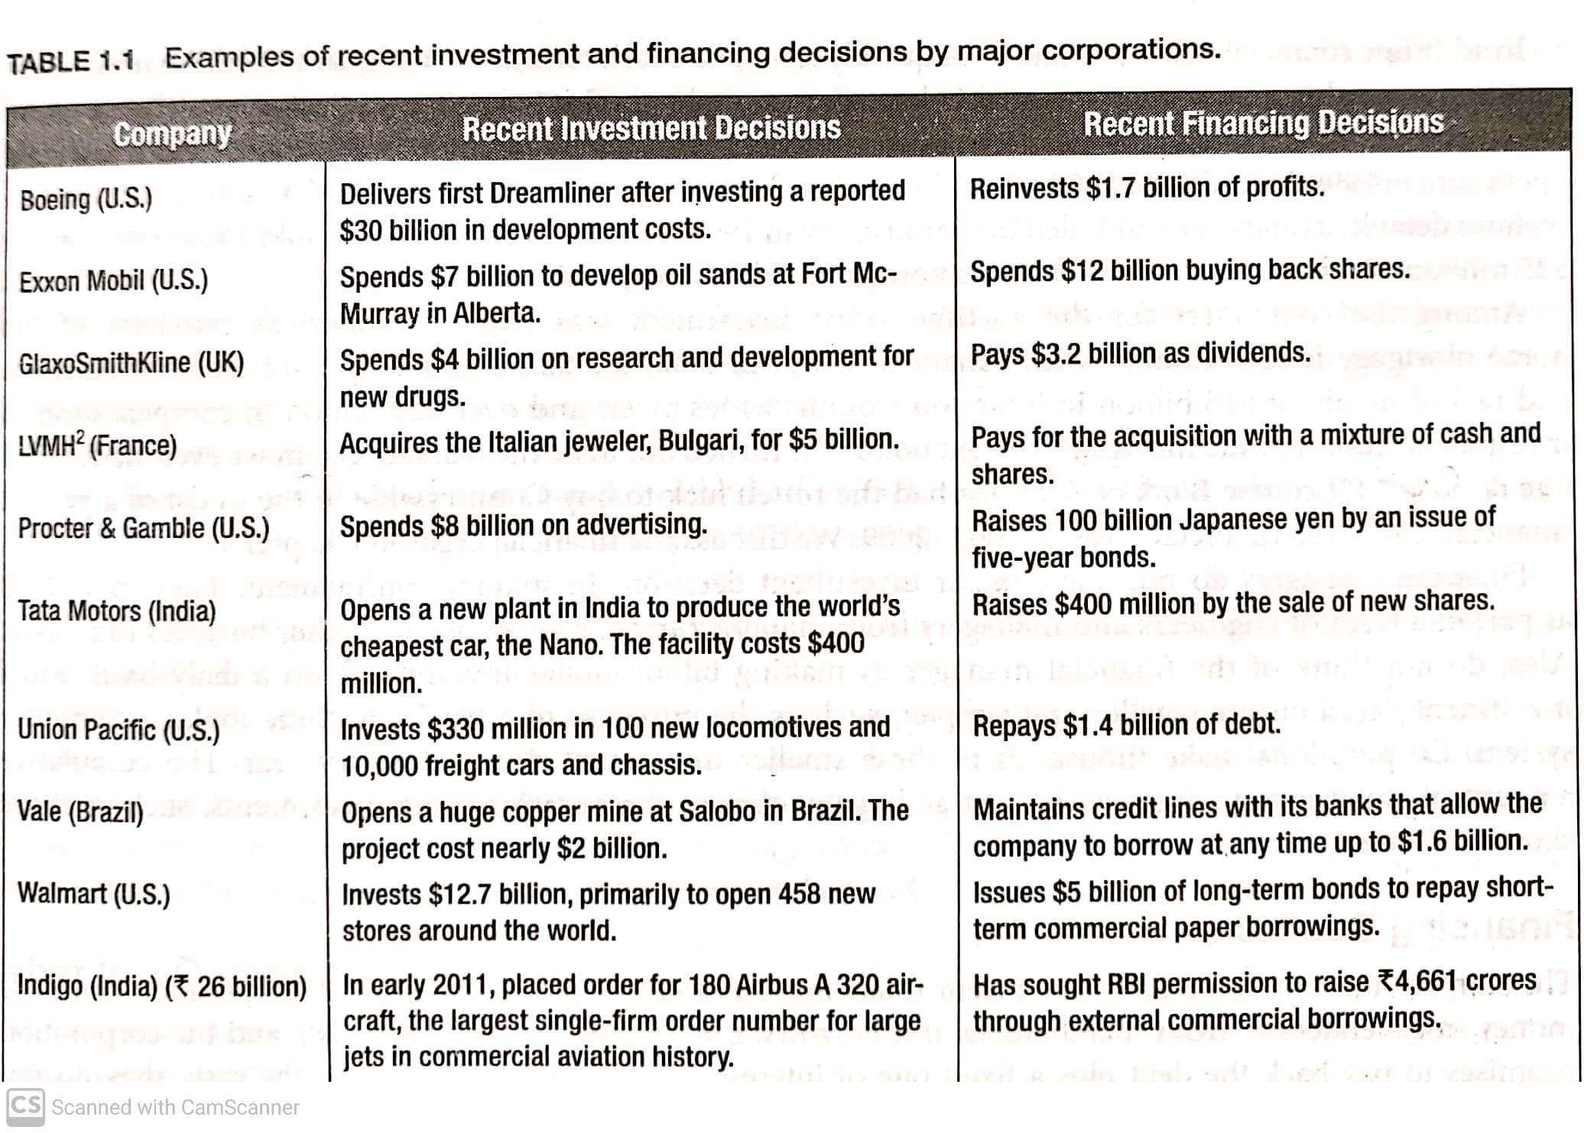

Slide 21
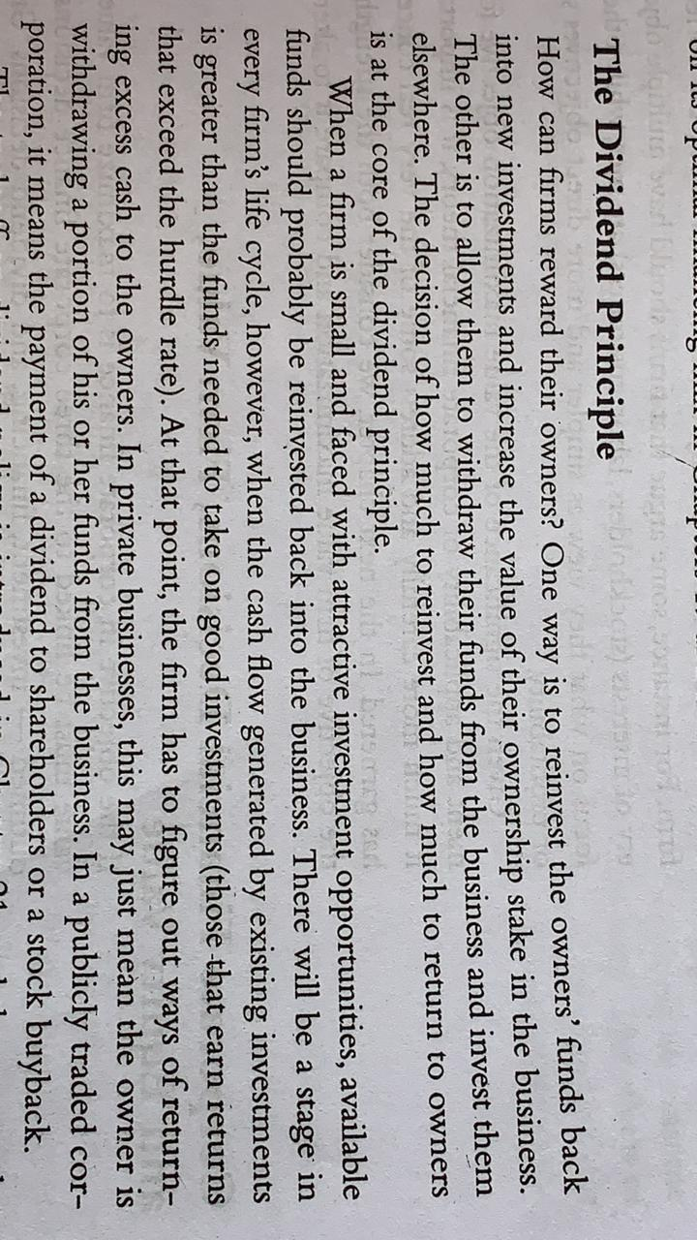
Dividend Decision

Slide 22
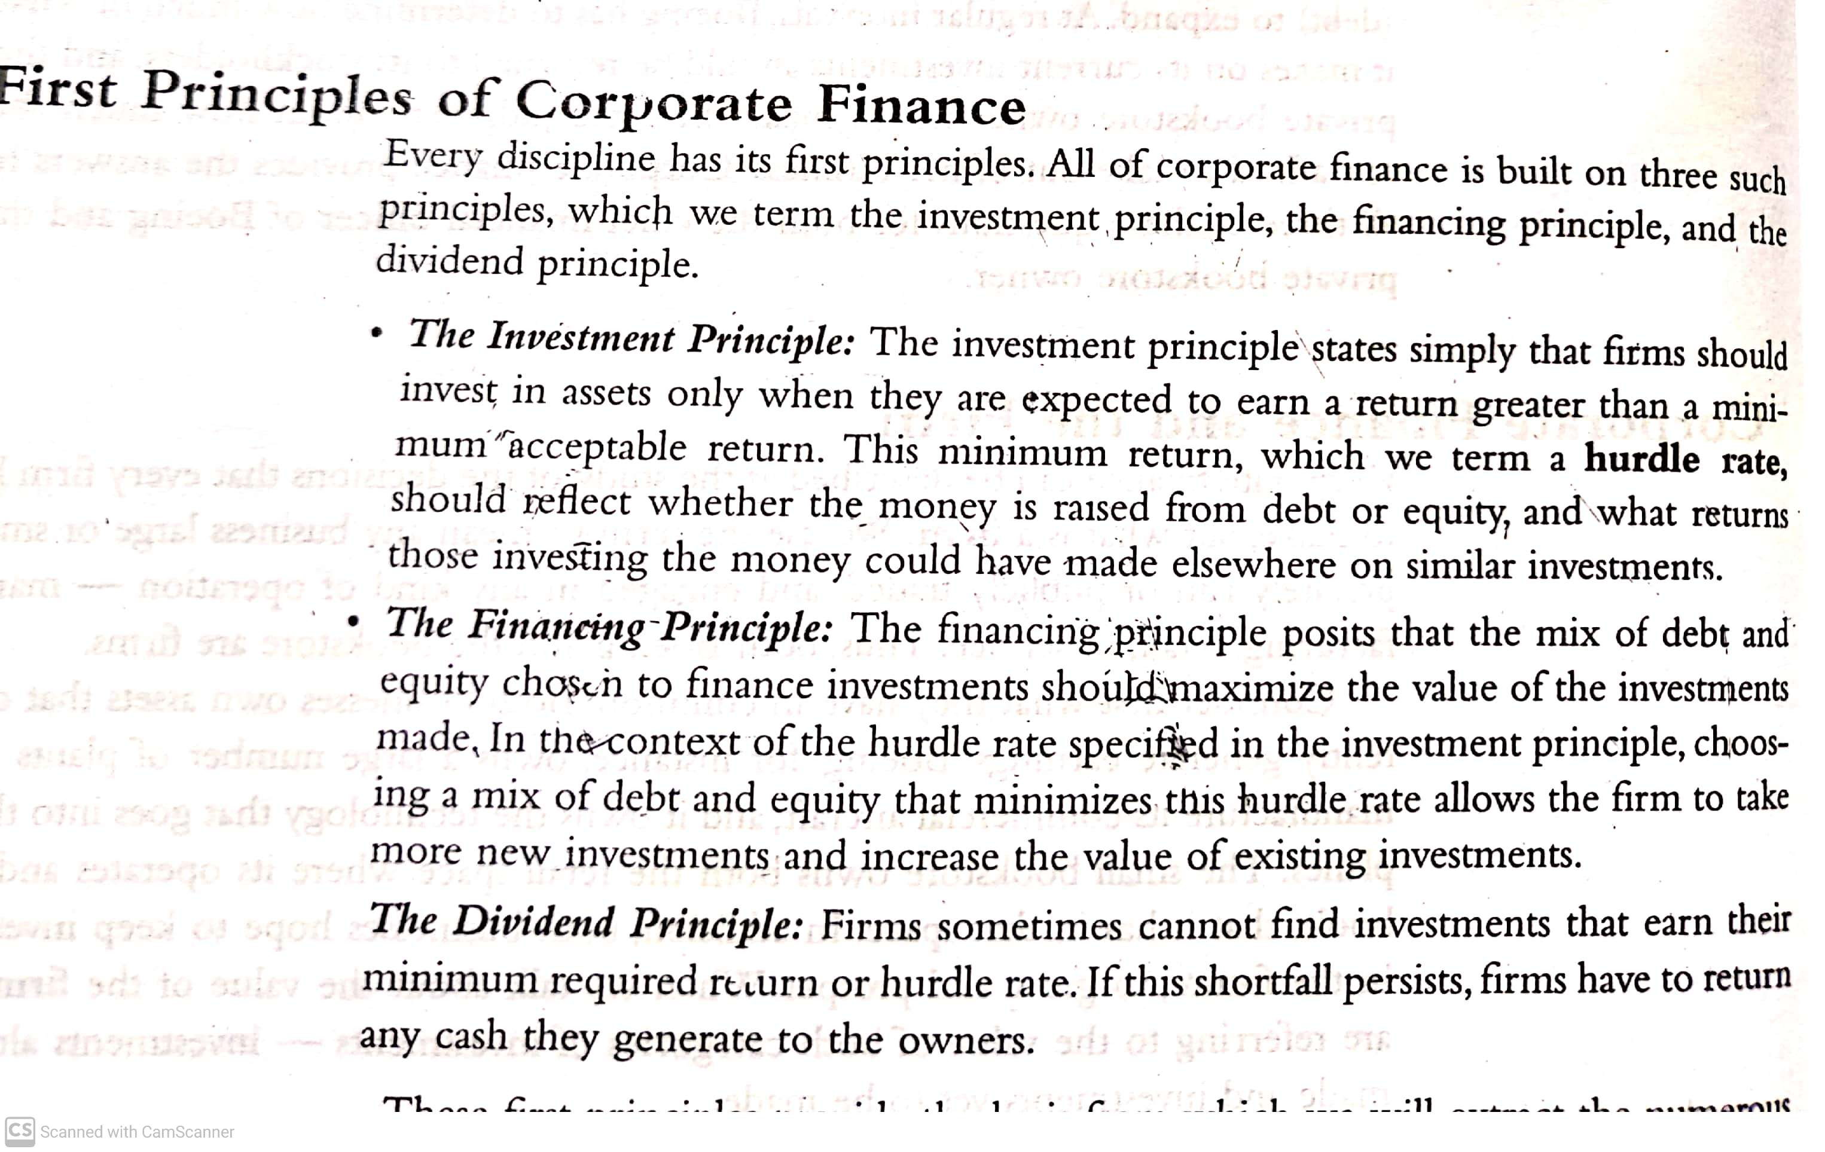
Three Principles

Slide 23
3 DECISION AREAS OF FM
INVESTMENT DECISION
CAPITAL BUDEGETING (LONG TERM)
WORKING CAPITAL (SHORT TERM)
FINANCING DECISION
EQUITY
DEBT
DIVIDEND DECISION
EQUITY DIVIDEND PAYOUT
RETAINED EARNING

Slide 24
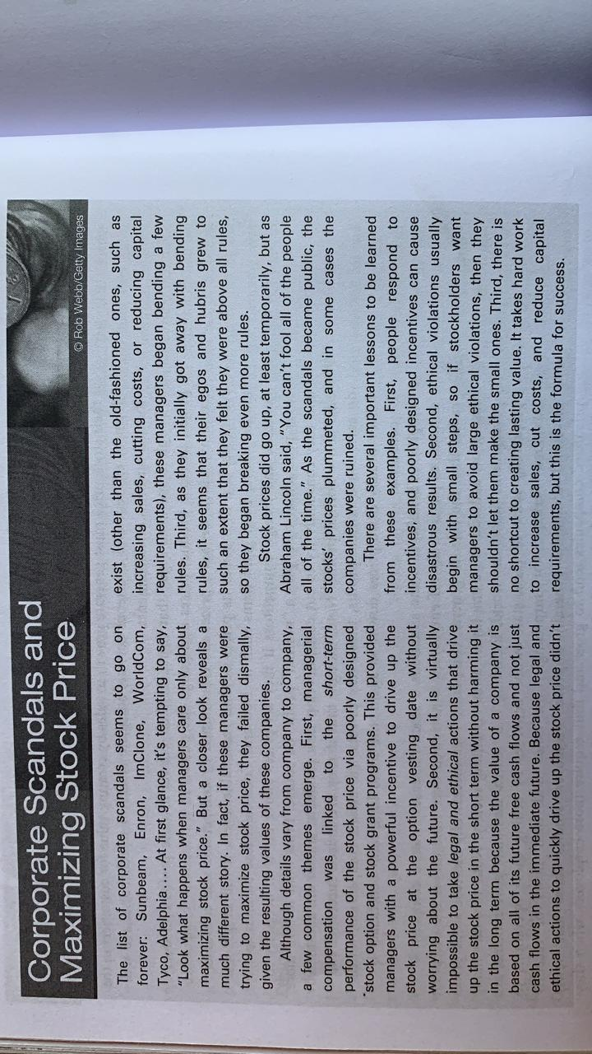

Slide 25
Corporate Objectives
What should be the Management’s primary objective?
How does maximizing the fundamentals stock price benefit society?

Slide 26
Objectives
Profit maximisation
EPS maximisation
Shareholder’s wealth maximisation
a) EPS MAX. = Earnings available to equity shareholder
No. of equity shares
b)Shareholders wealth/value of the firm= No. of equity shares * market price per share
MP/SHARE= Dividend income on the share + Sales proceeds on sale of share

Slide 27
Profit Maximization
Maximizing the rupee income of a firm
Pros :
✓Resources are efficiently utilized
✓Appropriate measure of firm performance
✓Serves interest of society also
Objections to Profit Maximization:
It is Vague
It Ignores the Timing of Returns
It Ignores Risk
Assumes Perfect Competition
In new business environment where corporate are limited companies (not sole proprietors) Profit maximization is regarded as
Unrealistic, Difficult, Inappropriate

Slide 28
Maximizing Profit after Taxes or EPS
Ignores timing and risk of the expected benefit.
Maximizing EPS will not result in highest price for company's shares.
Maximizing EPS implies that the firm should make no dividend payment so long as funds can be invested at positive rate of return—such a policy may not always work.

Slide 29
Shareholders’ Wealth Maximization
Maximizes the net present value of a course of action to shareholders.
Value of the firm = Number of equity shares x Market price per share
Fundamental objective—maximize the market price of the firm’s shares.
Accounts for the timing and risk of the expected benefits as time value of money is considered when net present value of a course of action is determined.
Considers the risk and uncertainty factor while considering the discounting rate. The discounting rate reflects both time and risk. Higher the uncertainty, the discounting rate is higher and vice-versa
Benefits are measured in definite terms of cash flows (not in terms of profits which is vague).
It looks at long-term sustainability of the business which was ignored in profit Maximization

Slide 30
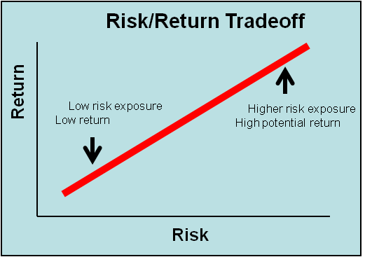
Risk return trade off
Direct relationship between risk and return
Upward slopping curve
Higher the risk | Higher the return
Lower the risk | Lower the return

Slide 31
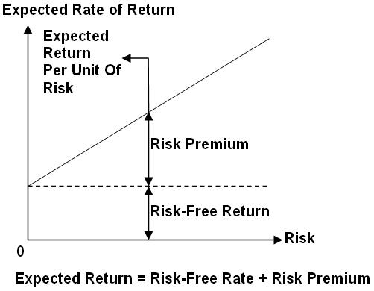
 | Return | Risk Premium
FD(Nationalised bank) | 6%
FD(Private company) | 9% | 6%+ 3%
Debentures | 12% | 6%+6%
Preference share | 15% | 6%+9%
Equity shares | 18% | 6%+ 12%
Risk premium increases as the risk increases
Risk premium will vary between the instruments
Rate of return= risk free rate+ risk premium

Slide 32
 | Risk | Return
Cash(in hand) | 0 | 0
Savings(Bank) |  | 4%
FD(Nationalised) |  | 6%
FD(Private company) |  | 9%
Debentures(Private company) |  | 12%
Preference shares |  | 15%
Equity shares |  | 18%
We consider two instruments as risk free return
Treasury bills(Issued by govt.)
FD(Nationalised bank)
Risk premium-is the additional risk instrument is having. It is the compensation given for additional risk taken .

Slide 33
Risk profiles
1.Aggressive- High risk,high return
They invest mainly in equity
2.Moderate- Debt+ equity(balanced between debt and equity)
3. Conservative- Low risk, Low return. Invest in Debt.

Slide 34
AGENCY PROBLEM
AGENCY: The relationship between two parties in which one (the 'agent') is under the control of (is obligated to) the other (the ‘principal') . The agent is authorized by the principal to perform certain acts, for and behalf of the principal
SEPARATION OF OWNERSHIP AND MANAGEMENT
OWNERSHIP: It belongs to equity shareholder
MANAGEMENT: It belongs to Board of Director or Agent

Slide 35
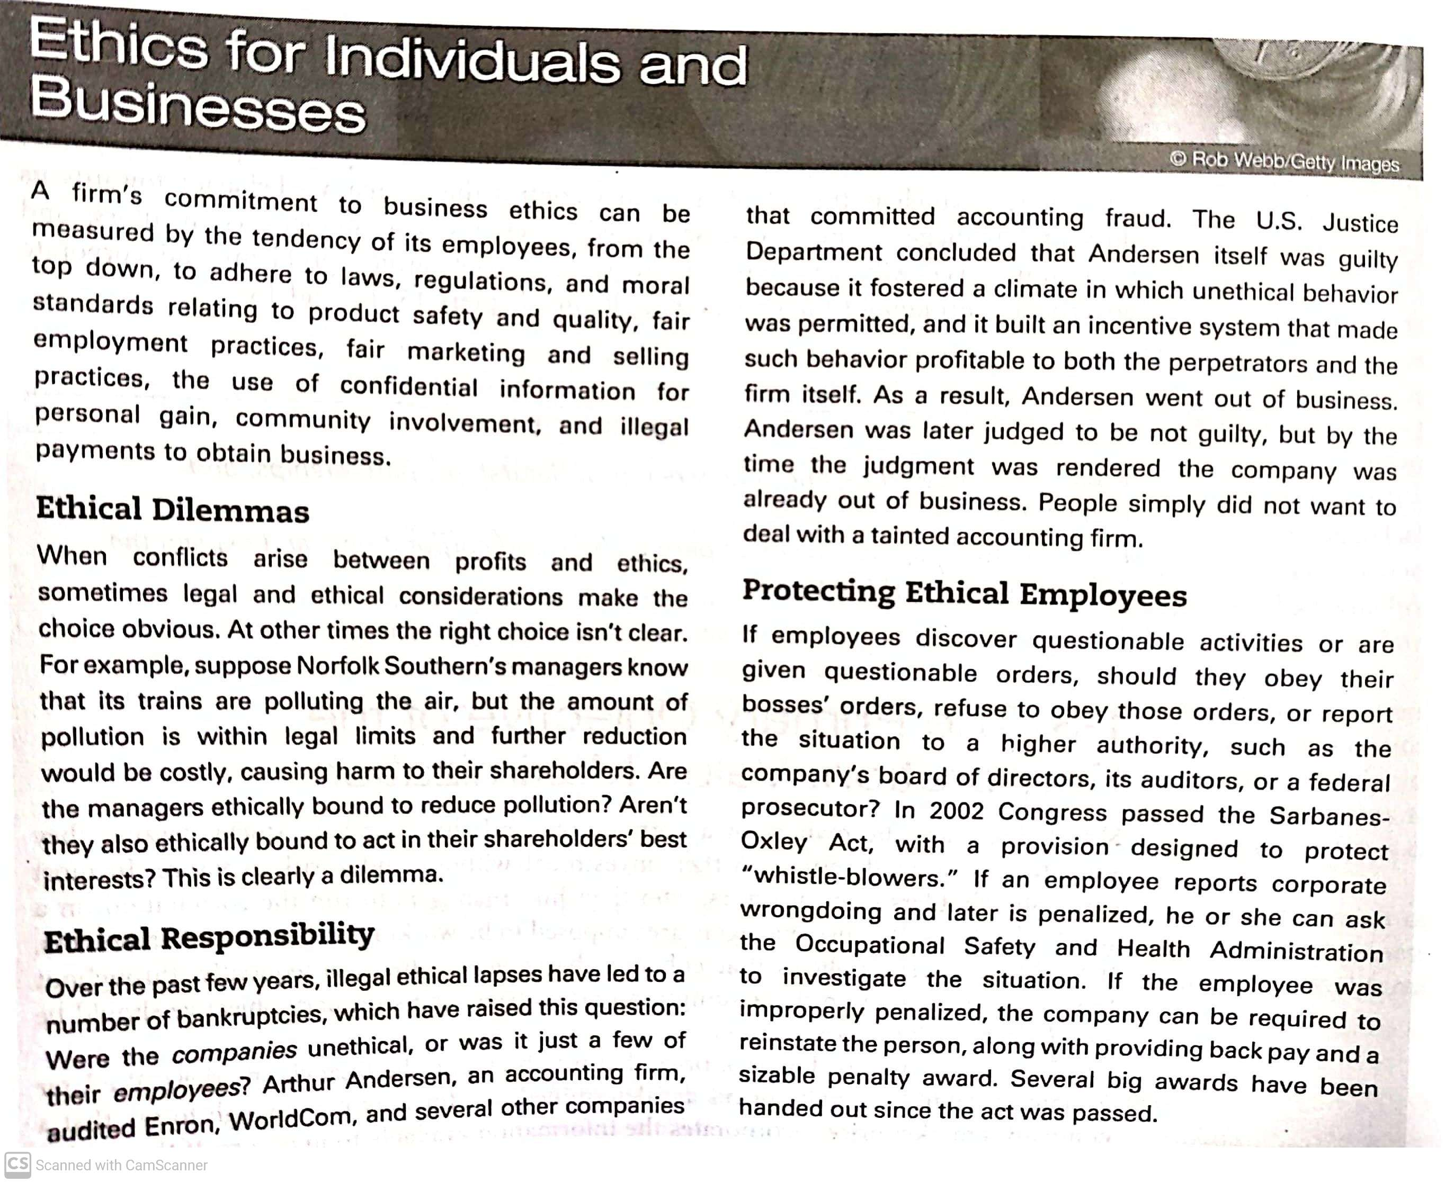

Slide 36
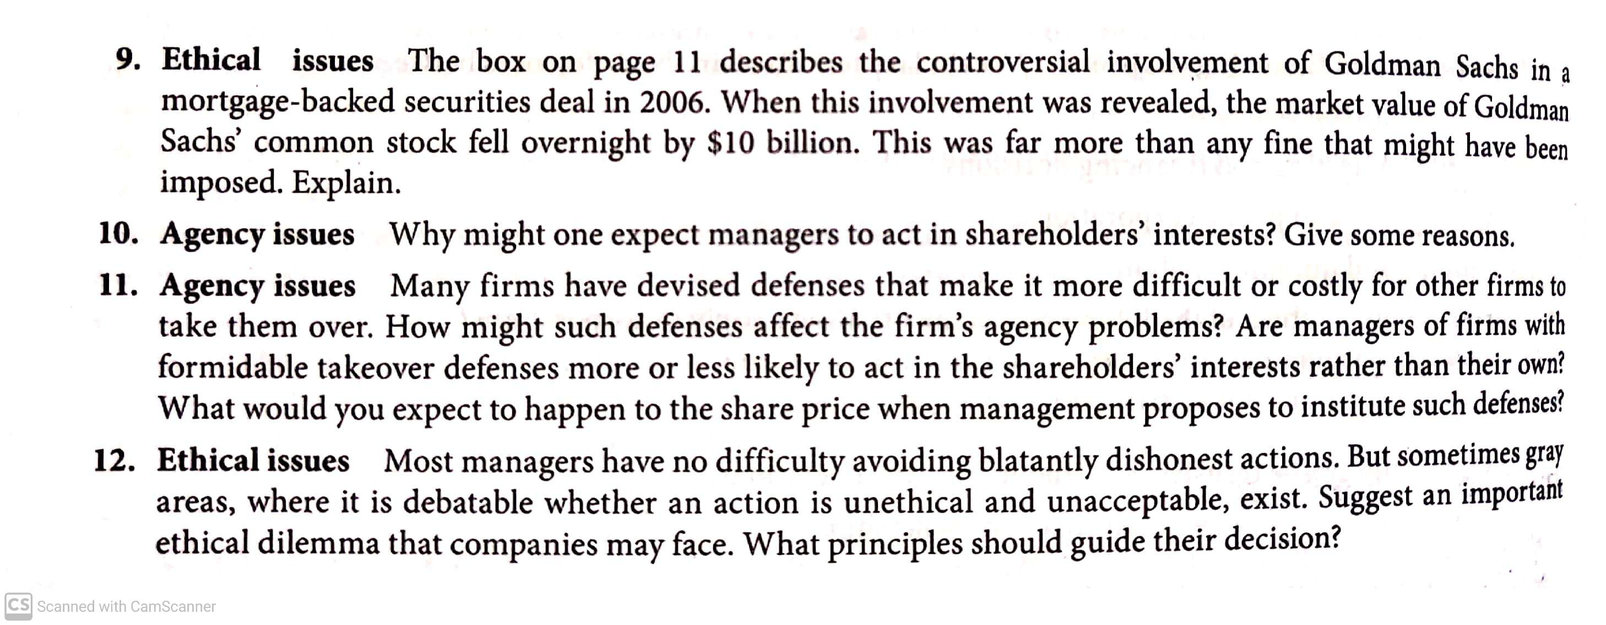

Slide 37
Can Accounting & Corporate Finance go together?

Slide 38
Financial Accounting what is done or what is the main activity in Financial Accounting
Statement of Profit and Loss Account is prepared for a period
Sales – Expenses =Profit
Financial Position of the Company – Balance sheet
Cash goes out of the business and cash comes into the business –
Cash Flow statement

Slide 39
10000 Ringitts per month *12 months =120000 Ringitts
January 2022-December 2023 at the end of a year what will be my
Financial position is arrived at a particular or on a particular day

Slide 40
Company
Sales , manufacturing I will adjust all this in profit and loss account statement and arrive at the profit or loss
But the company long term assets or long term borrowings is shown only in the balance sheet along with the short term borrowings and short term assets
Cash flow statement =Cash inflows and Cash out flows

Slide 41
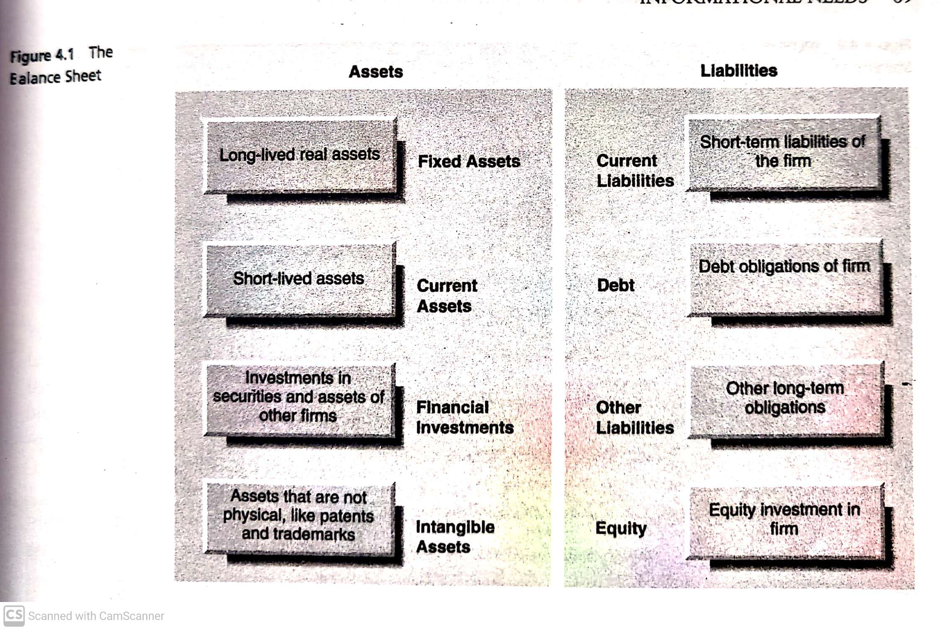

Slide 42
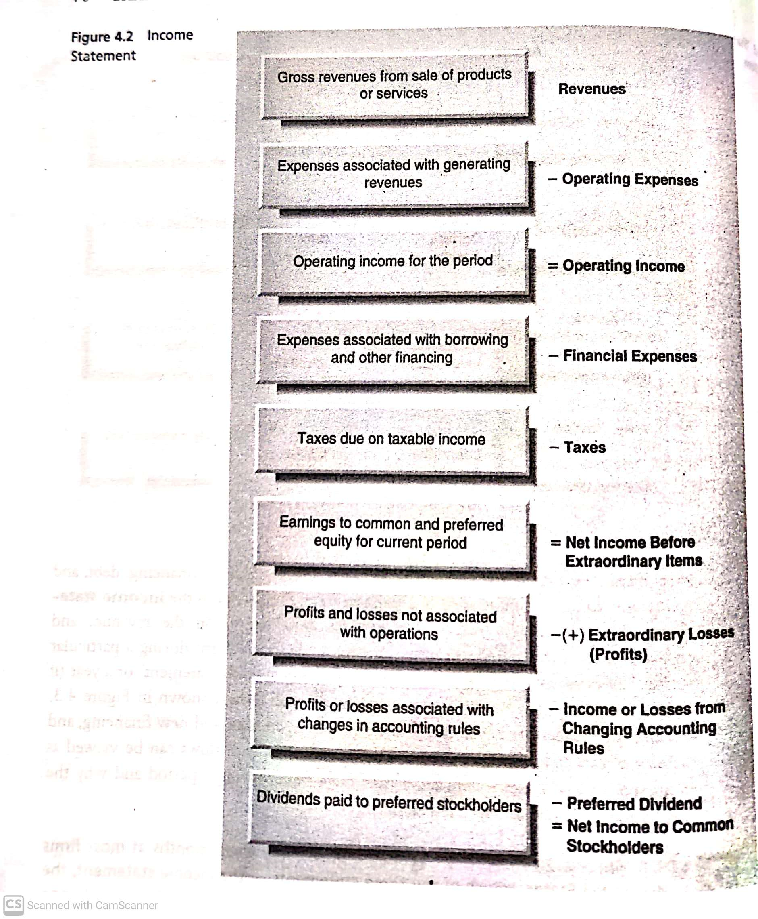

Slide 43
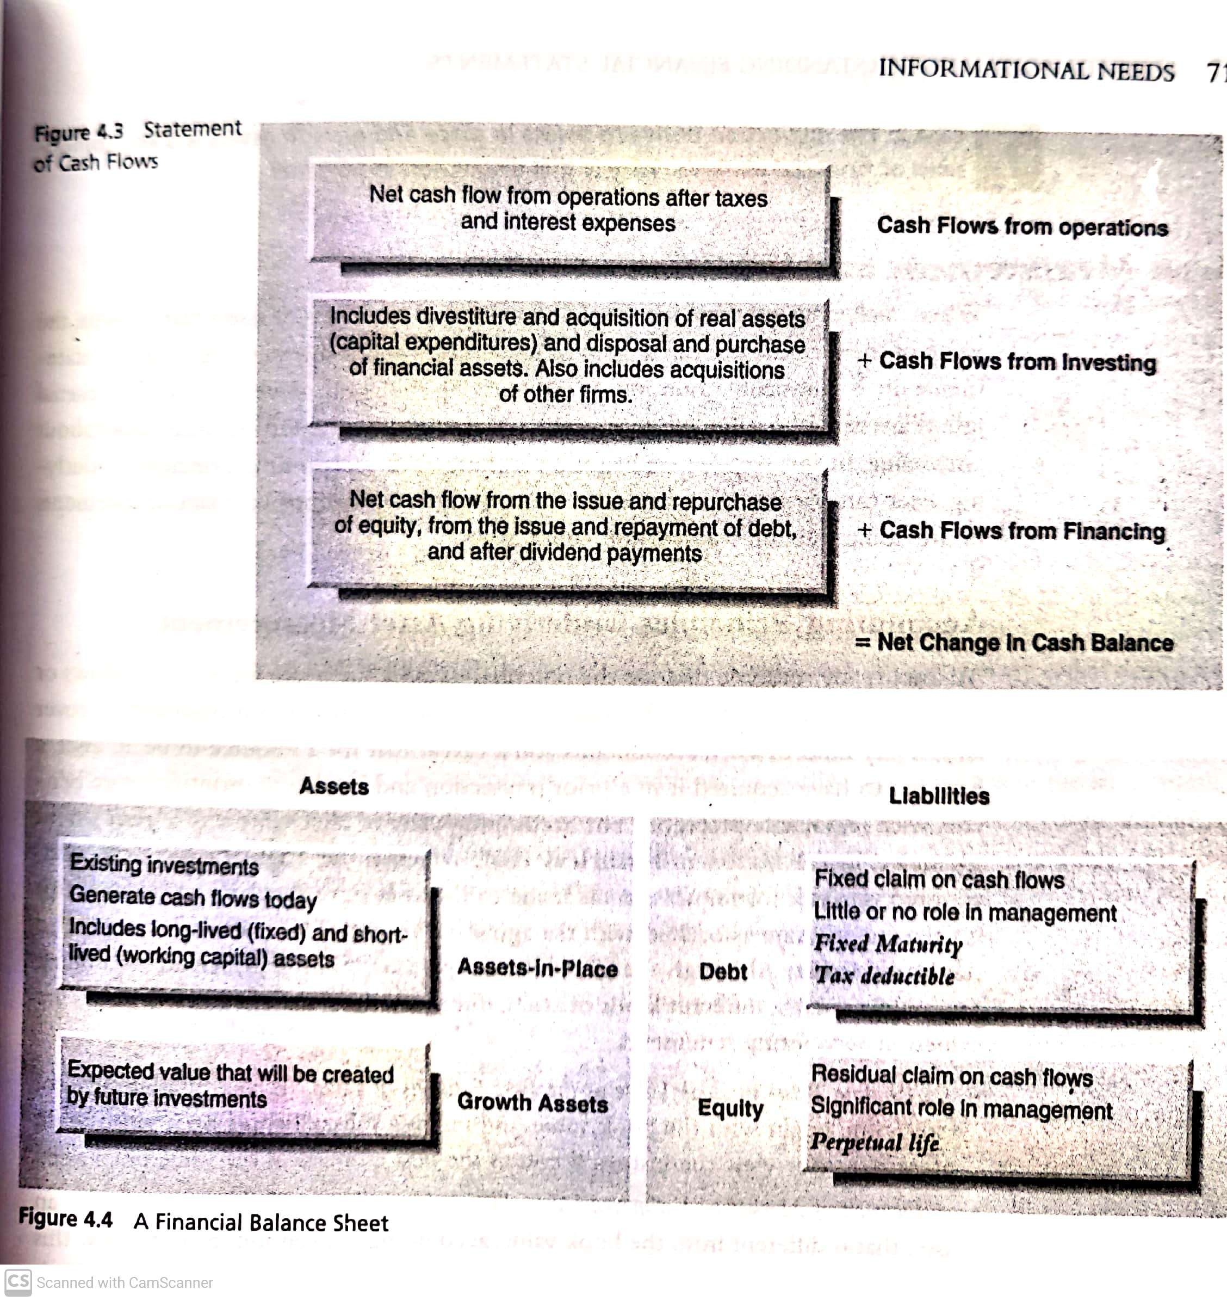

Slide 44
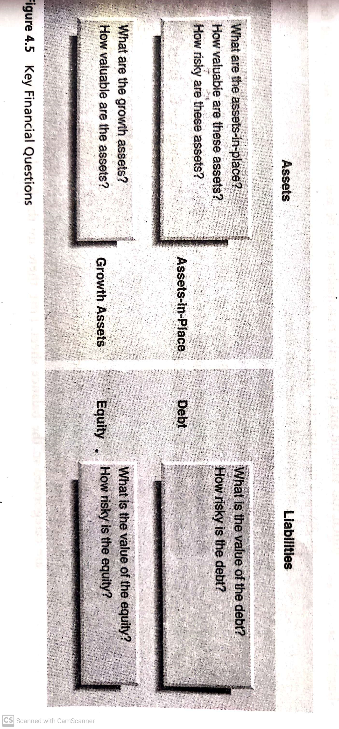

Slide 45
P/L Statement:
Sales
- Variable Cost
= Contribution
- Fixed Cost
= EBIT
- Interest
= EBT
- Tax Paid
= EAT
- Preference Dividend Paid
= Equity Available To Equity Share
- Equity Dividend Paid
= Retained Earning
INVESTMENT DECISION
FINANCING DECISION
DIVIDEND DECISION

Slide 46
BALANCE SHEET
Capital Budgeting decision
Financing Decision
Dividend decision
PERIOD
LIABILITY
ASSETS
LONG TERM
SHORT TERM
EQUITY
PREFERENCE
RESERVES AND SURPLUS
DEBENTURE
LONG TERM LOAN
CREDITORS
OUTSTANDING EXPENSES
SHORT TERM LOAN
LAND AND BUILDING
PLANT
MACHINERY
PATENT
GOODWILL
LONG TERM INVESTMENT
CASH & BANK BALANCE
STOCK
DEBTORS
SHORT TERM INVESTMENT
Working capital decision

Slide 47
3 DECISION AREAS OF FM
INVESTMENT DECISION
CAPITAL BUDEGETING (LONG TERM)
WORKING CAPITAL (SHORT TERM)
FINANCING DECISION
EQUITY
DEBT
DIVIDEND DECISION
EQUITY DIVIDEND PAYOUT
RETAINED EARNING

Slide 48
Assignment
Select four types of industry Airlines, Auto, Telecommunications & Pharma.
How many companies are there in each industry and total sales in each industry?
Do the industry with largest total sales have the most companies in the industries?
What does it tell you about competition in the industry?

